Slide 1
Introduction to the Standard Template Library
Standard Template Library (STL): a library containing generic templates for implementing abstract data types (ADTs) and algorithms
Not supported by many older compilers, but included in any compiler for the latest standard: C++11

Slide 2
Standard Template Library
Important structures in the STL:
containers: classes that store data and impose some organization on it
iterators: like pointers; mechanisms for accessing elements in a container

Slide 3
Containers
Two types of container classes in STL:
sequence containers: organize and access data sequentially, as in an array. These include vector, deque, and list
associative containers: use keys to allow data elements to be quickly accessed. These include set, multiset, map, and multimap

Slide 4
Iterators
Generalization of pointers, used to access information in containers
Four types:
forward (uses ++)
bidirectional (uses ++ and -- )
random-access
input (can be used with cin and istream objects)
output (can be used with cout and ostream objects)
The type of container you use determines the type of iterator.
See example of vector iterators on page 1011, Gaddis 8th ed.

Slide 5
Algorithms
STL contains algorithms implemented as function templates to perform operations on containers.
Requires algorithm header file
algorithm includes
binary_search | count
for_each | find
find_if | max_element
min_element | random_shuffle
sort | and others
See pages 984-986. Gaddis 7th ed.

Slide 6
STL Vector
Templated class defined in the Standard Template Library
Holds a set of elements, like an array
Flexible number of elements - can grow and shrink
No need to specify size when defined
Automatically adds more space as needed
Must include vector header file to use vectors
#include <vector>
Chapter 7, page 429 (Gaddis 8th ed)

Slide 7
Vectors
Can hold values of any type
Type is specified when a vector is defined
vector<int> scores;
vector<double> volumes(20);
Can use [] to access elements volumes[0] = 72.55;

Slide 8
Defining Vectors
Define a vector of integers (starts with 0 elements)
vector<int> scores;
Define int vector with initial size 30 elements
vector<int> scores(30);
Define 20-element int vector and initialize all elements to 0
vector<int> scores(20, 0);
Define int vector initialized to size and contents of vector finals
vector<int> scores(finals);
Notes:
See pr8-22.cpp

Slide 9
Growing a Vector’s Size
Use push_back member function to add an element to a full array or to an array that had no defined size
// Add a new element with value 75
scores.push_back(75);
Use size member function to determine number of elements currently in a vector
howbig = scores.size();
Notes:
See pr8-23.cpp and pr8-24.cpp

Slide 10
Removing Vector Elements
Use pop_back member function to remove last element from vector
scores.pop_back();
To remove all contents of vector, use clear member function
scores.clear();
To determine if vector is empty, use empty member function
if (!scores.empty()) ...
Notes:
See pr8-25.cpp, pr8-26.cpp, and pr8-27.cpp

Slide 11
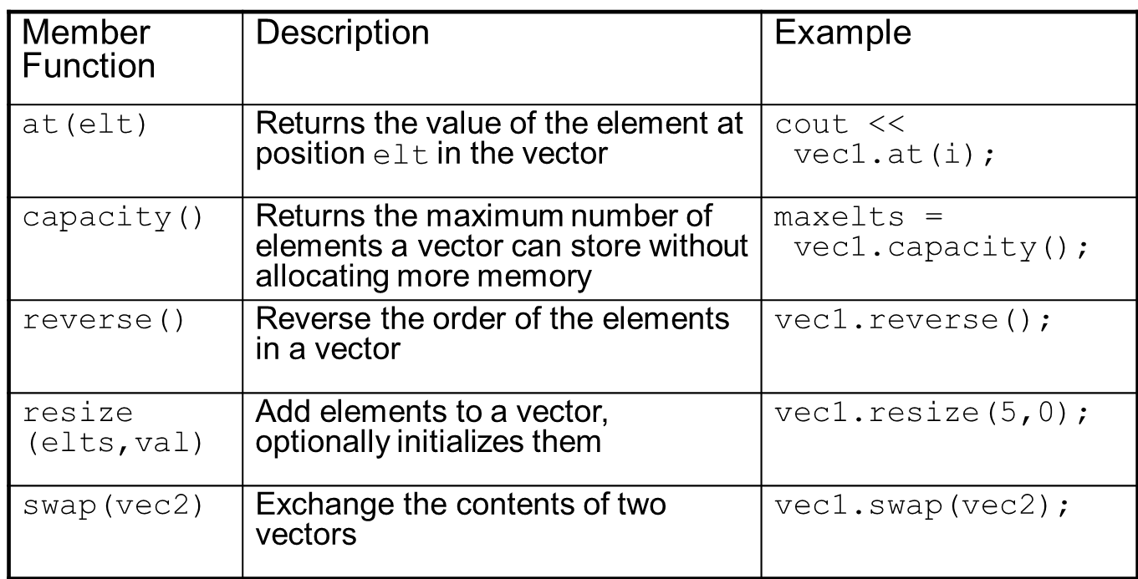
Other vector member functions

Slide 12
More vector member functions
See chapter 16, page 1012-1013 (Gaddis 8th ed)
back(), begin(), end(), erase(..), front(), insert(..), resize(..)

Slide 13
Example of using algorithms see page 1013
#include <iostream>
#include <vector>
#include <algorithm>
using namespace std;
int main(){
vector<int> vect; int value;
.
. //input values into vect
.
random_shuffle(vect.begin(), vect.end());
sort(vect.begin(), vect.end());
if ( binary_search(vect.begin(),vect.end(), value)
. . .

